Slide 1
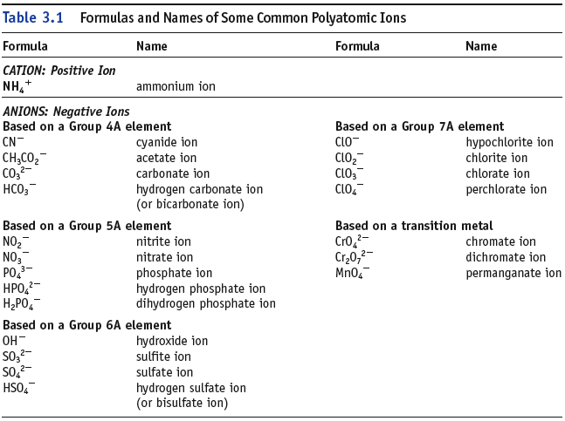
Note: many O containing anions have names ending in –ate (or -ite).

